Slide 1


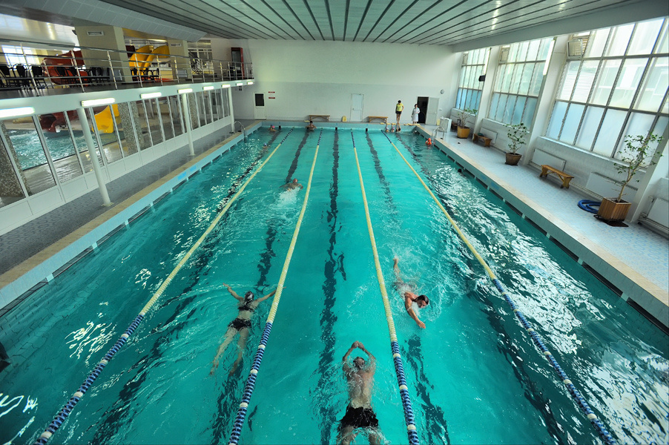
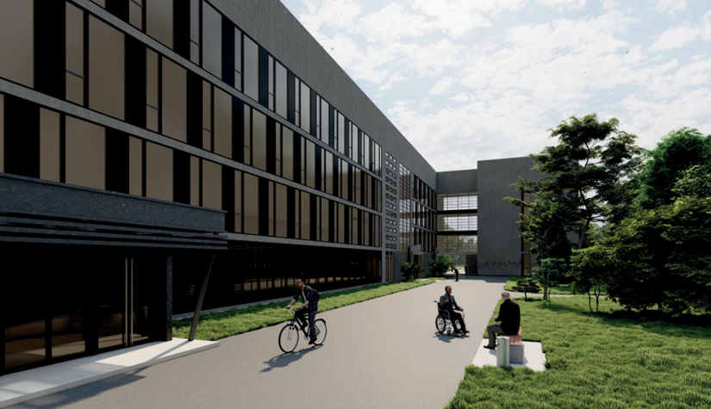
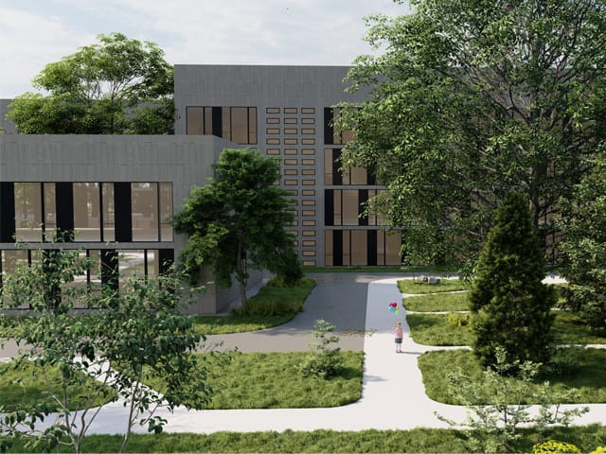



Overhaul of Municipal
non-profit enterprise
“Cherkasy City Infectious Diseases Hospital”
(hospital department for rehabilitation of war veterans)

Slide 2
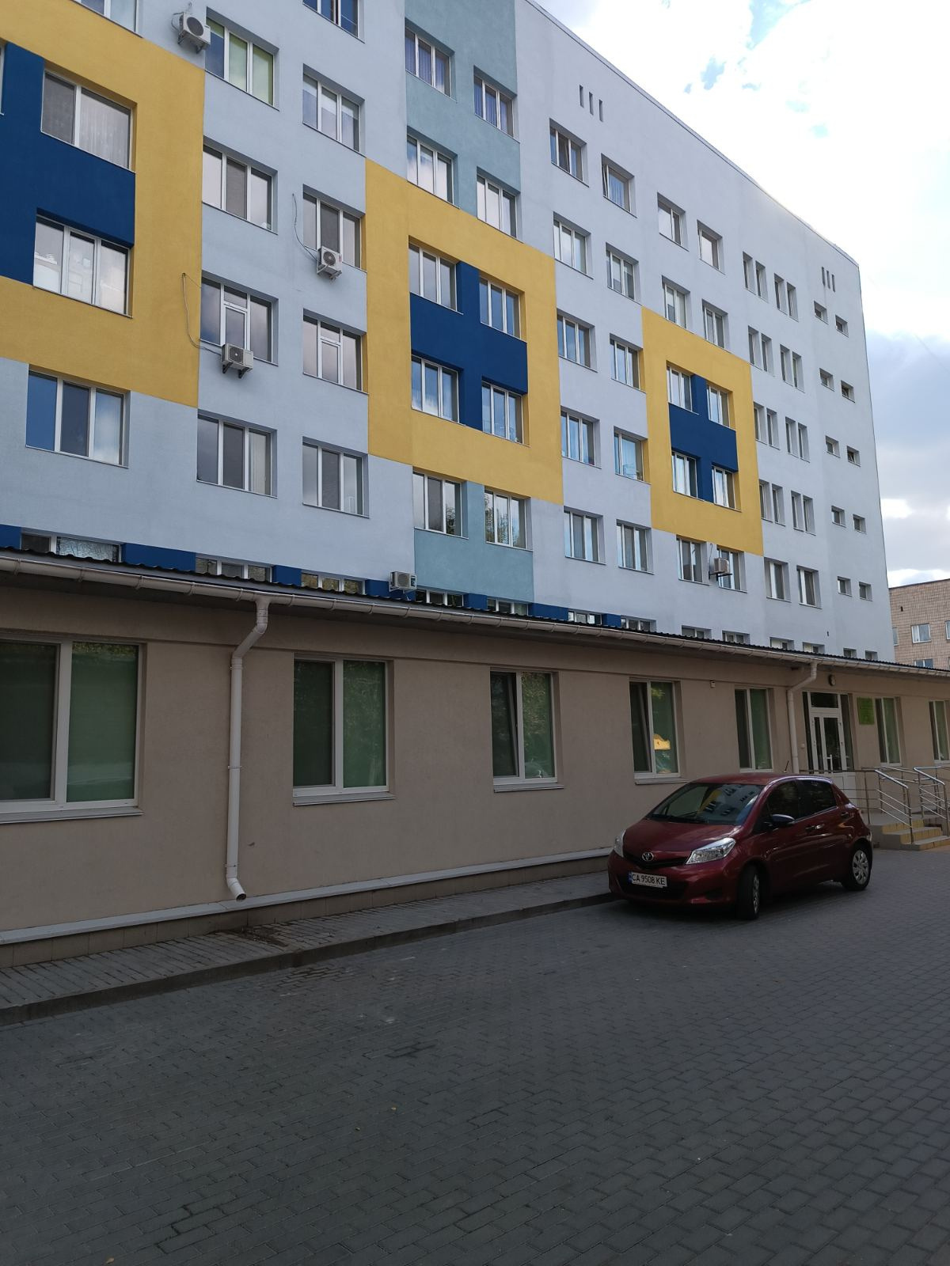
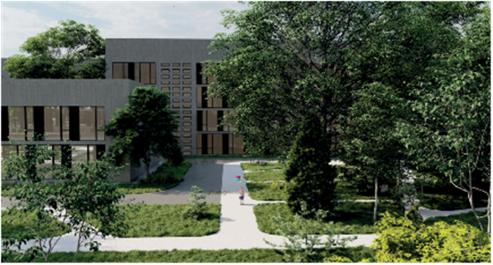
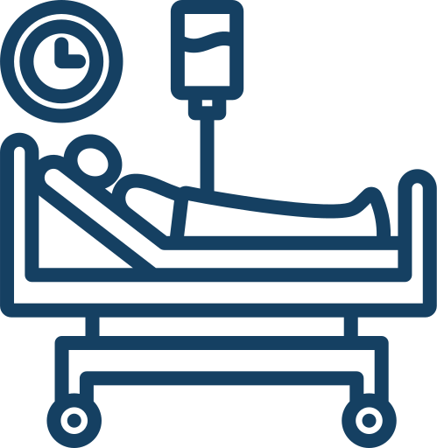
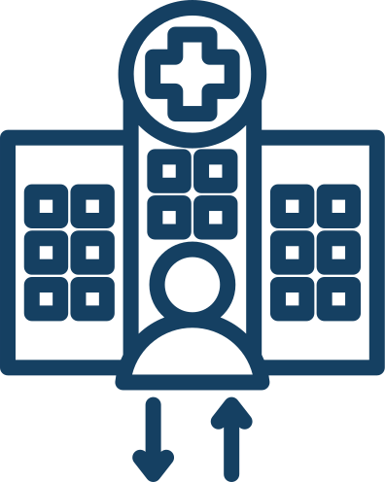






Overhaul of Municipal non-profit enterprise “Cherkasy City Infectious Diseases Hospital”
(hospital department for rehabilitation of war veterans)
Number of people who received the service:
Inpatient treatment - 873 people
Outpatient treatment - 3 600 people
Provision of specialized care 24/7
The total cost of the project is
≈ 1 980 000 EUR

Slide 3

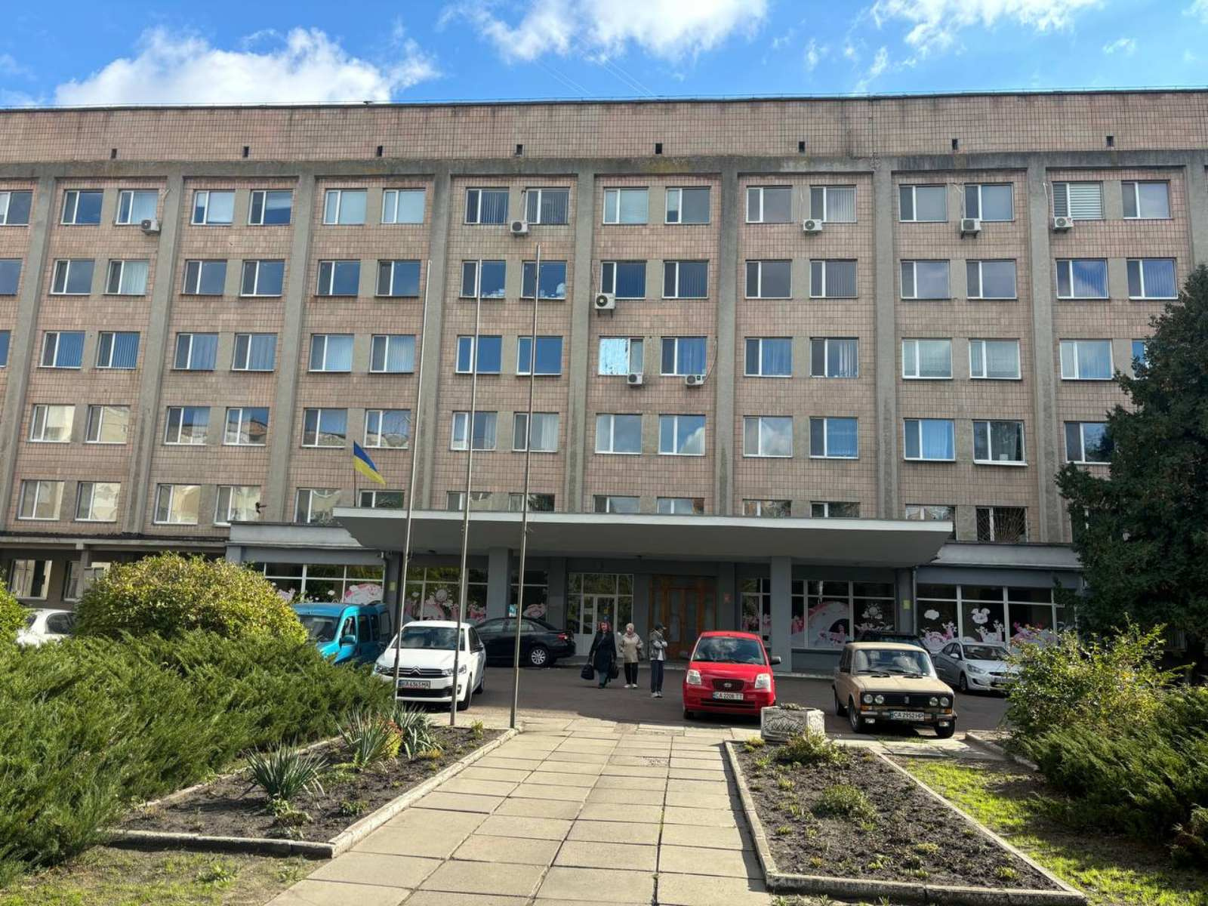









The project includes the following works:
Repair works will ensure:
renovation of a department with an area of ​​1,200 sq.m. with the arrangement of wards for 30 beds with the stay of 2 people in the ward
Reconstruction of wards and halls for rehabilitation
Replacement of windows and doors
Internal construction and installation works
Replacement of power grids and electrical equipment
Replacement of internal water supply and sewage networks
Replacement of the floor covering
The assistance model includes:
Provision of planned highly specialized assistance for the rehabilitation of war veterans on a 24-hour basis
Implementation of new rehabilitation methods in practice, analysis of their effectiveness, implementation of best practices of the best rehabilitation centers
Exchange of professional experience

